Slide 1
Teradata Training
Day 7 -- 11/06/2018

Slide 2
Topics
Between
IN
Not IN
Union
Union All
Intersect
Except / Minus

Slide 3
Between , IN, NOT IN
BETWEEN command is used to check if a value is within a range of values.
Syntax: SELECT EmpNo, FName FROM Testdb1.Employee
WHERE EmpNo BETWEEN 101 AND 103;
IN command is used to check the value against a given list of values.
Syntax: SELECT EmpNo, FName FROM Testdb1.Employee
WHERE EmpNo IN( 101,103);
NOT IN command reverses the result of IN command. It fetches records with values that don’t match with the given list.
Syntax: SELECT EmpNo, FName FROM Testdb1.Employee
WHERE EmpNo NOT IN( 101,103);

Slide 4
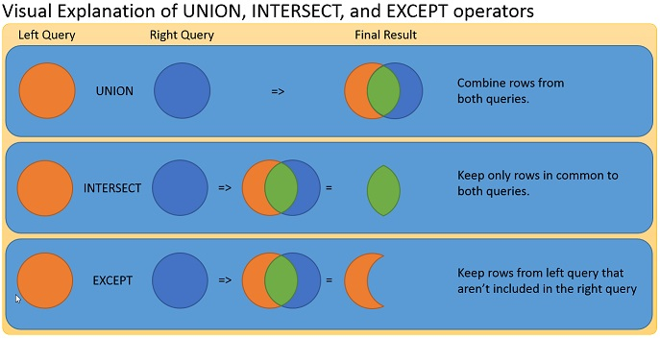
Union, Intersect and Except

Slide 5
Union and Union All
UNION statement is used to combine results from multiple SELECT statements. It ignores duplicates.
Syntax: SELECT * FROM Testdb1.Employee
union
SELECT * FROM Testdb1.Employee;
UNION ALL statement is similar to UNION, it combines results from multiple tables including duplicate rows.
Syntax: SELECT * FROM Testdb1.Employee
union all
SELECT * FROM Testdb1.Employee;

Slide 6
Intersect and Minus
INTERSECT command is also used to combine results from multiple SELECT statements. It returns the rows from the first SELECT statement that has corresponding match in the second SELECT statements. In other words, it returns the rows that exist in both SELECT statements.
Syntax: SELECT EmployeeNo FROM Testdb1.Employee
INTERSECT --- intersection(common)
SELECT EmployeeNo FROM Testdb1.EmpSalary;
MINUS/EXCEPT commands combine rows from multiple tables and returns the rows which are in first SELECT but not in second SELECT. They both return the same results.
Syntax: SELECT EmployeeNo FROM Employee
MINUS
SELECT EmployeeNo FROM Testdb1.EmpSalary;

Slide 7
Interview Questions
Display the dept information from department table.
Syntax: select * from department;
Display the details of all employees.
Syntax:select * from employees;
Display the name and job for all employees.
Syntax:Select name, job from employees;
Display name and salary for all employees.
Syntax:select name, salary fro employess;
Display employee number and total salary for each employee.
Syntax: select employee_number, total_salary from employee;
Syntax: select employee_number, sum(deduction,netpay)
From employee
Groupby employee_number;

